Slide 1

Project by
Goutham Yallapu
Monish Kumar Naidu Pinapala

Slide 2

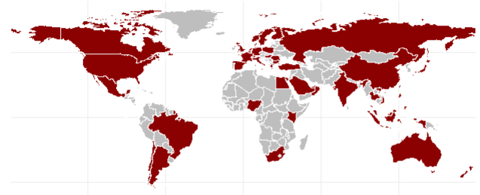
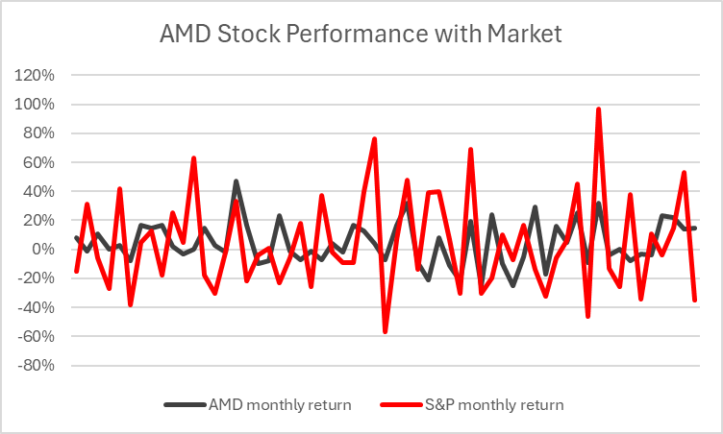
Company Overview
Global Presence
Diversified Semiconductor product range.
Global operations in over 50 countries.
Commitment to innovation, investing heavily in R&D to drive technological advancements and product differentiation.
Business model is characterized by consistent growth, profitability, and value creation for shareholders.
Significant revenue growth in recent years, driven by strong demand for high-performance computing and graphics products.

Slide 3

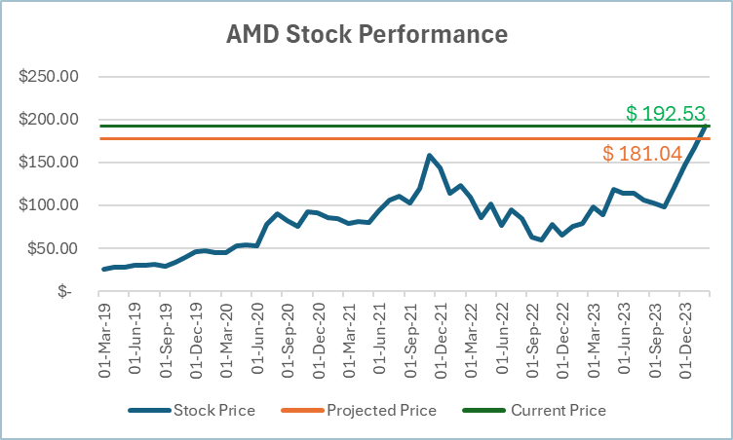
Market Profile
(Closing Price 02/29/23) | $192.53
52 Week High | $193.00
52 Week Low | $78.52
Average Volume | 73,982,469
Market Cap | $311.088B.
Beta | 1.63
EPS Ratio | 0.53
Institutional ownership | 94.46% of Outstanding shares

Slide 4
S
W
O
T
STRENGTHS | WEAKNESSES | OPPORTUNITIES | THREATS
Innovation in Product Line Strategic Partnerships Competitive Performance | Supply Chain Constraints Competition for Market Share Reliance on Limited Clientele | Growing AI Market PC Market Recovery Expansion into Emerging Markets | Intense Competition Technological Obsolescence Economic Downturns

Slide 5
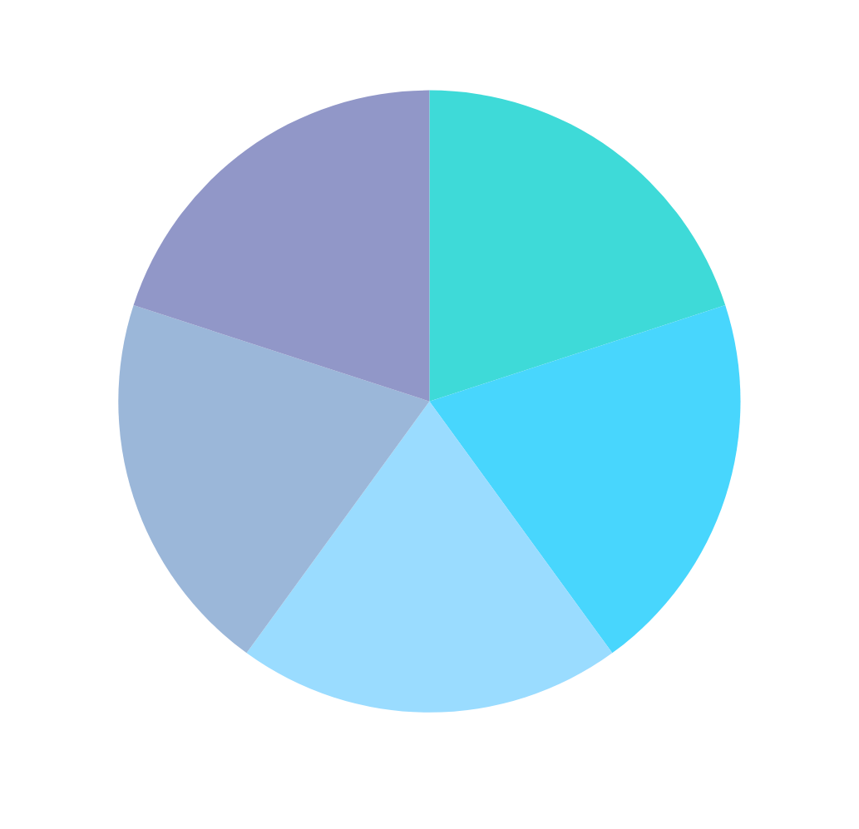
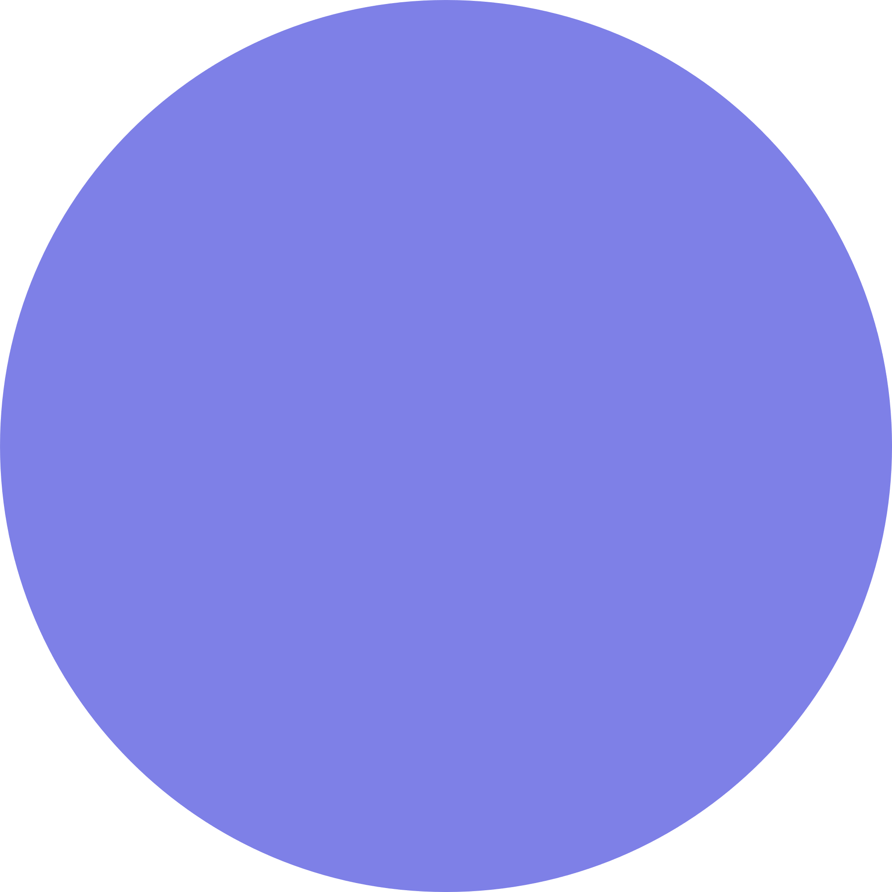




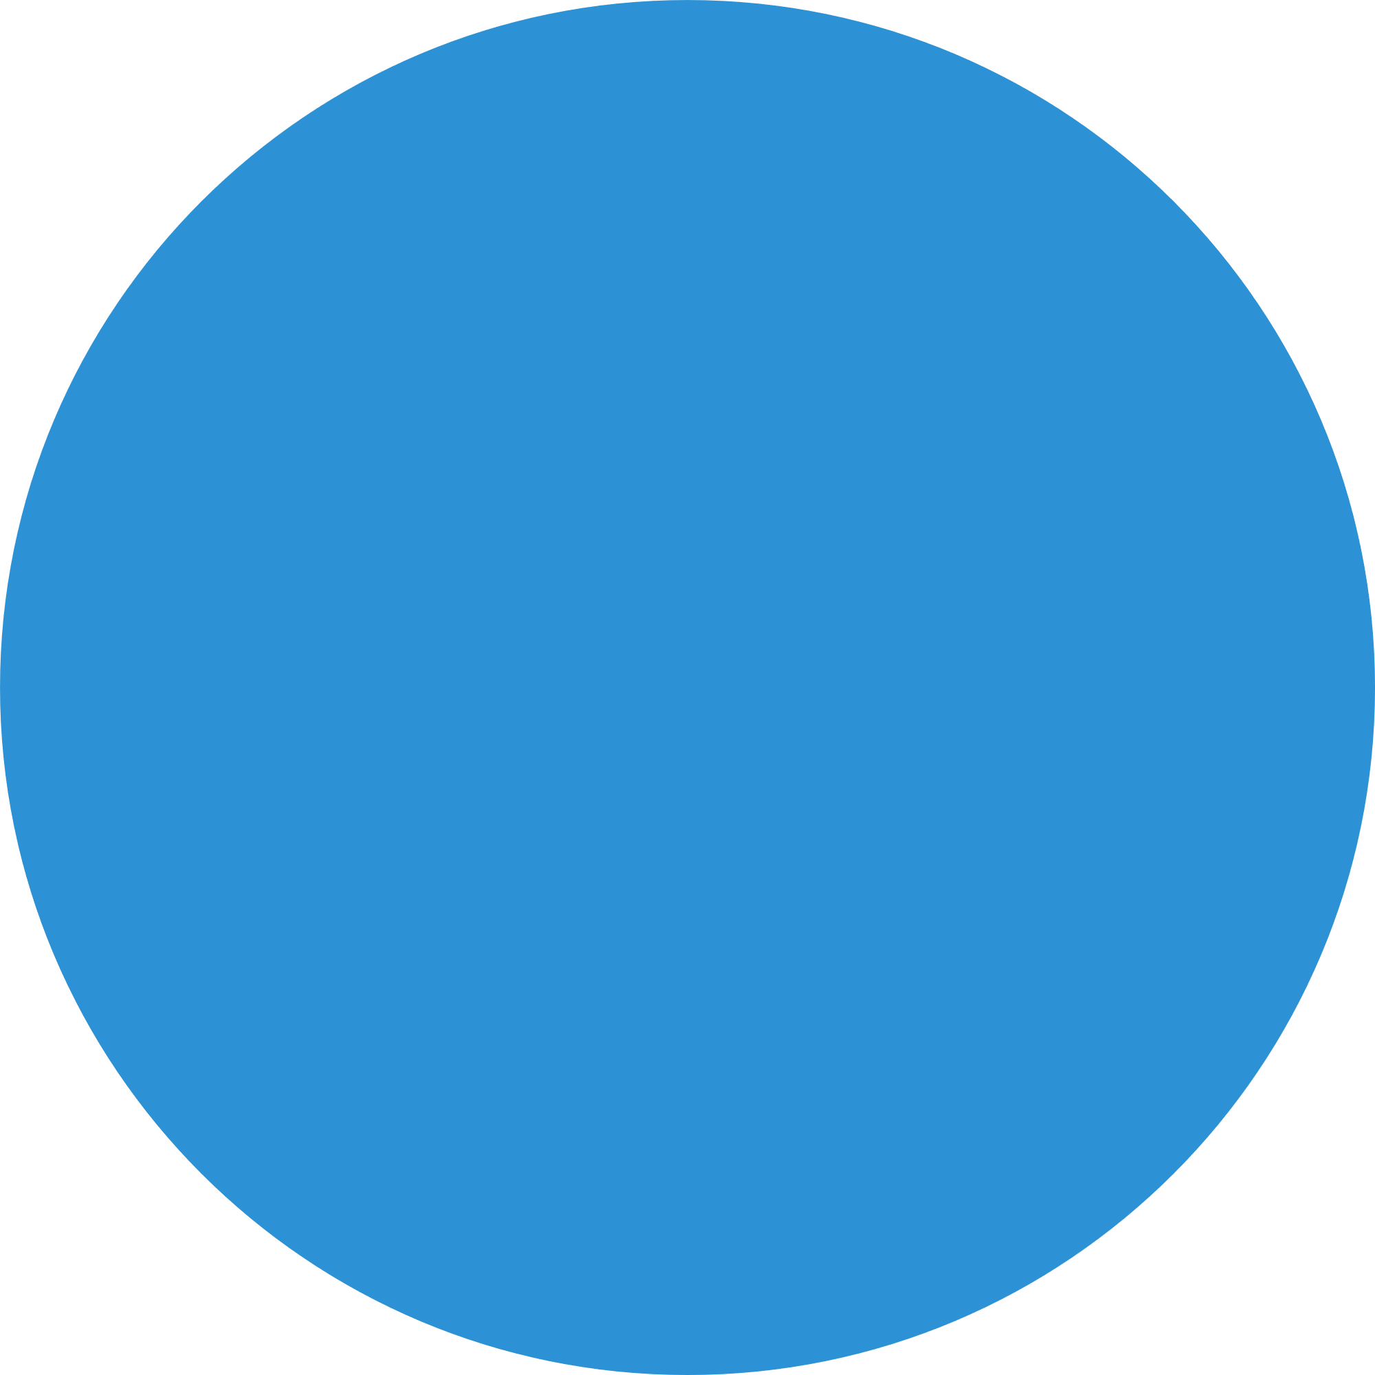




PORTER'S FIVE FORCE ANALYSIS
Rivalry amoung Existing Competitors:
High
Threat of New Entrants:
Low to Moderate
Bargaining Power of Suppliers:
Moderate
Threat of Substitute Goods or Services:
High
Bargaining Power of Buyers:
Moderate to High

Slide 6
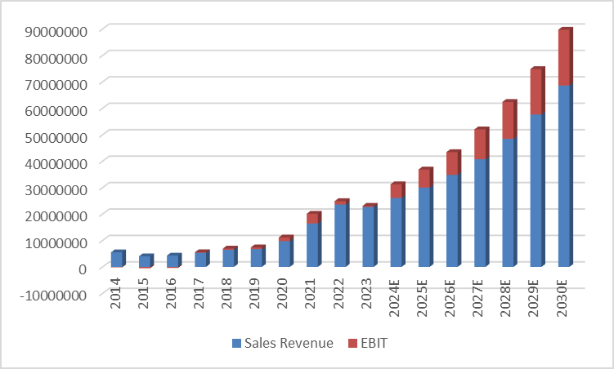
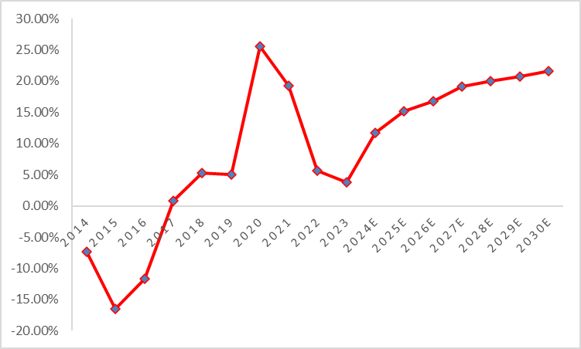
Financial Analysis
Revenue Analysis
Profitability Analysis
Actual
Actual
Projected
Projected

Slide 7
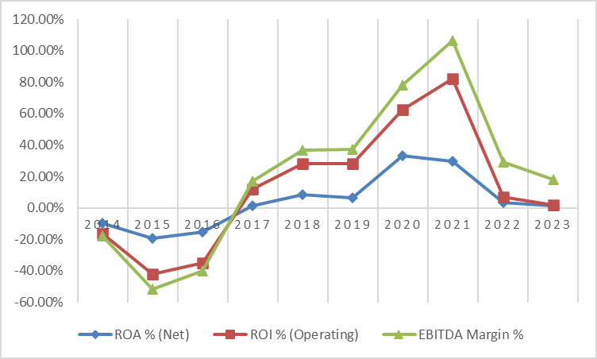
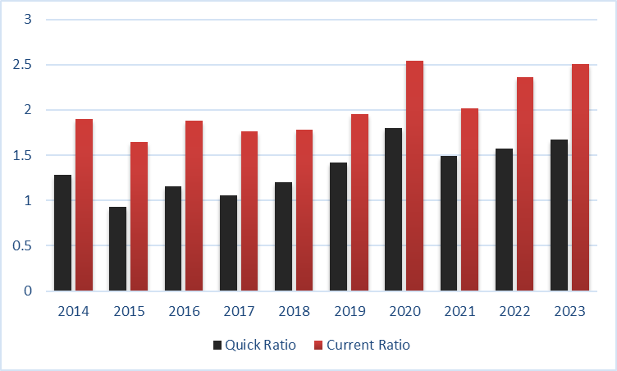
Financial Analysis
Profitability Analysis
Liquidity Analysis

Slide 8

Industry Analysis
Company Name | Market Cap (In Billions) | Net Income | Profit Margin | ROE
AMD Inc. | $ 311.00 | $ 2,723,000.00 | 10.44% | 18.33%
Intel Corporation | $ 182.00 | $ 1,689,000.00 | 3.11% | 202.78%
NVIDIA Corporation | $ 1,978.00 | $ 29,760,000.00 | 48.85% | 70.55%
Broadcom Inc. | $ 602.00 | $ 14,082,000.00 | 39.31% | 66.97%
Arm Holdings plc | $ 145.00 | $ 524,000.00 | 19.56% | 151.21%
TSM Company Limited | $ 667.00 | $ 325,408,164.80 | 44.92% | 219.30%
Micron Technology Inc | $ 105.83 | $ 6,856,000.00 | -37.54% | 283.91%
Applied Materials Inc. | $ 168.00 | $ 6,856,000.00 | 25.86% | 61.65%
Qualcomm Inc. | $ 176.00 | $ 6,856,000.00 | 19.14% | 60.25%

Slide 9
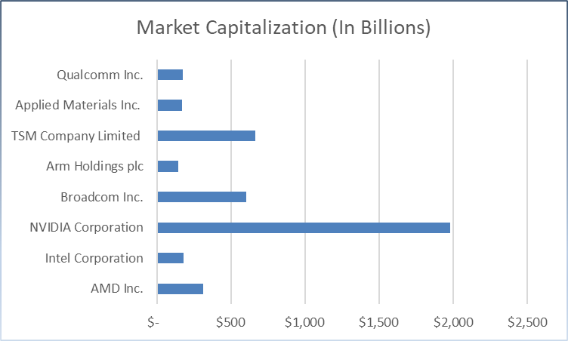

Industry Analysis and Competitive Positioning

Slide 10
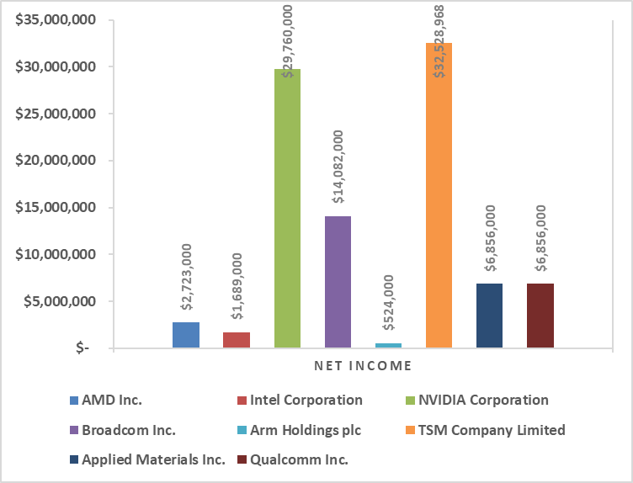
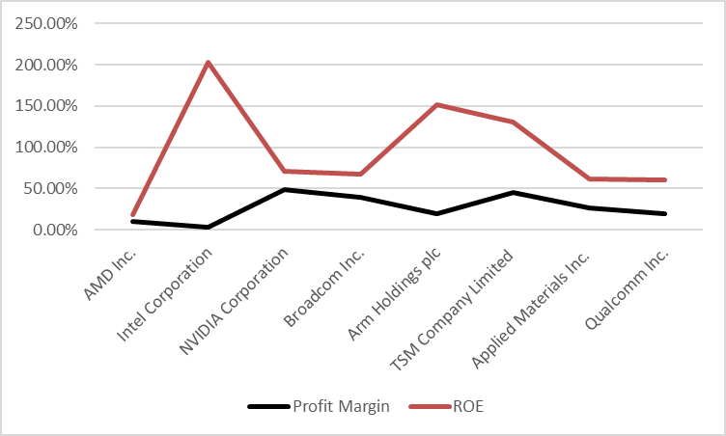
Industry Analysis and Competitive Positioning
Net Income
Profitability Ratios

Slide 11


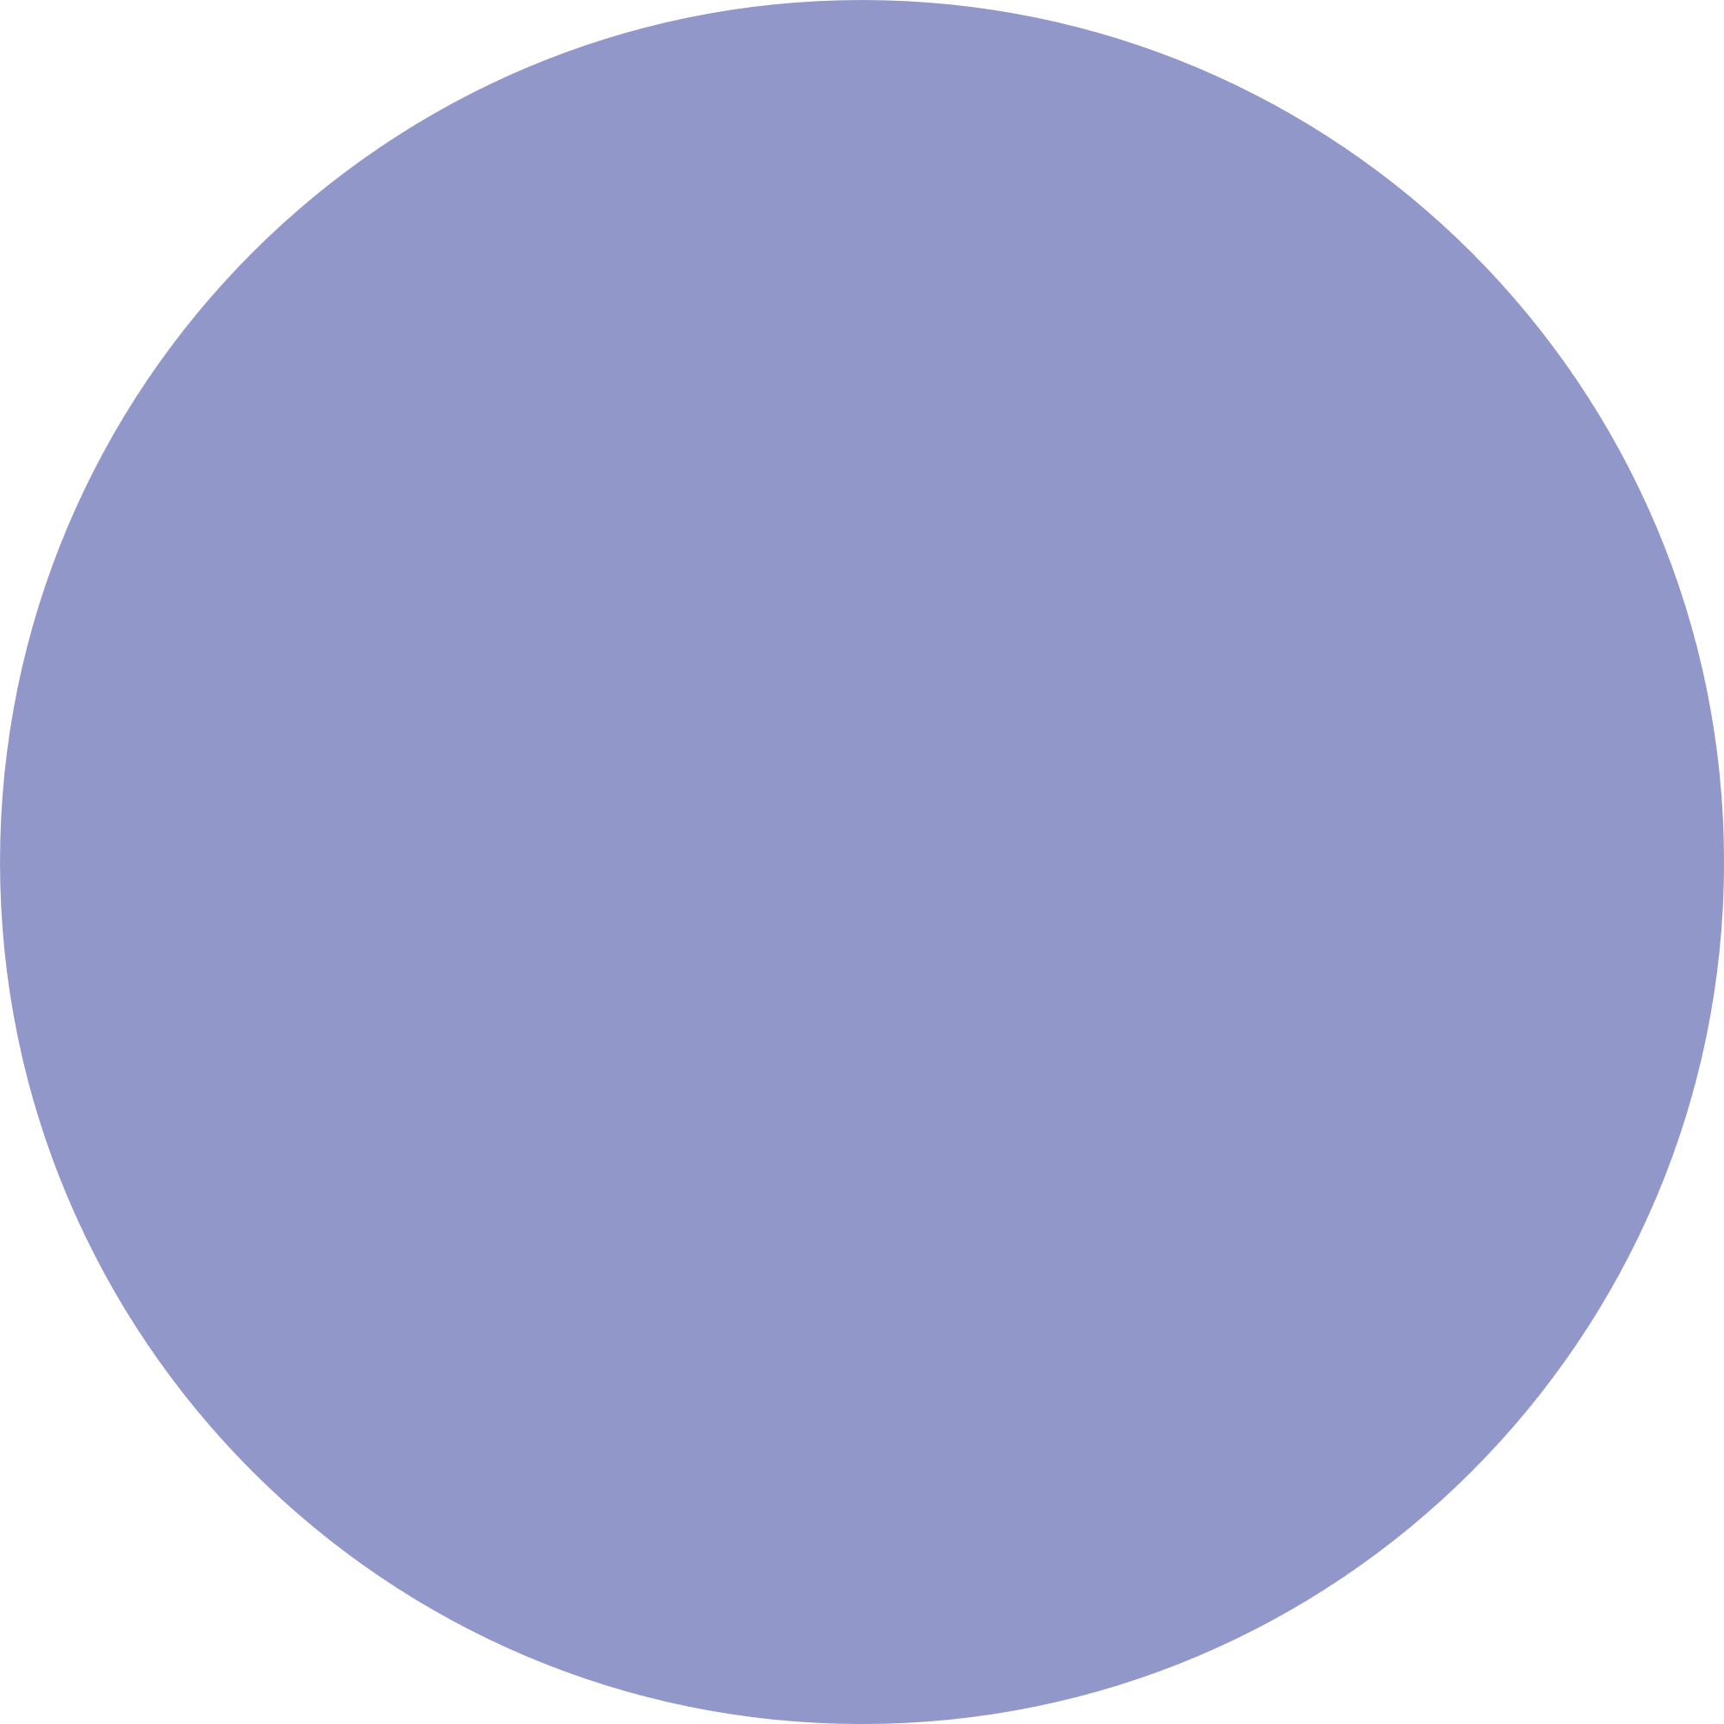

DCF Model Estimate
Market Risk Premium
Perpetual CF Growth
Risk free rate
Enterprise Value | $ 303,035,487
Enterprise Value per share | $ 187.52
Net Debt | $ 10,472,974
Equity Value | $ 292,562,513
Projected Stock Price | $ 181.04
Interest rate on debt
Beta
Risk free rate fluctuates between 3.75% to 4.25%
Market risk premium fluctuates between 3.75% to 4.25%
The perpetual cash flow rate is 6% and perpetual discount rate is 11.43%
Average Interest rate on debt is around 5%
Beta declined from 1.90 and settled at 1.50

Slide 12
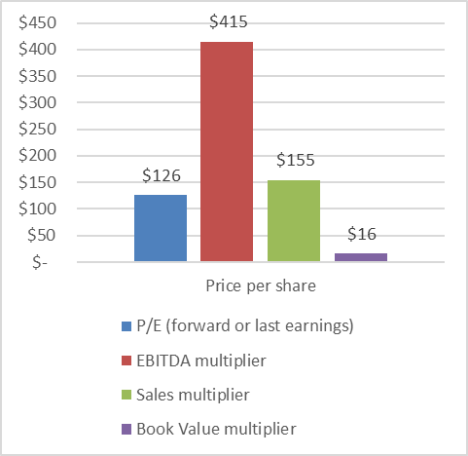
Relative Valuation
AMD | Cap Based on Average | Price per share
P/E (forward or last earnings) | $ 203,512,556 | $ 126
EBITDA multiplier | $ 1,691,072,044 | $ 415
Sales multiplier | $ 421,886,679 | $ 155
Book Value multiplier | $ 83,144,927 | $ 16
Average Valuation Price
$ 178

Slide 13

Risk Analysis
Tech and
Innovation
Ability to Sell
Legal &
Regulatory
Macro &
Political
Heavy R&D Investment
Obsolescence Risk
Supply Chain Distribution
Market Demand and its Competition
Dependency on Suppliers
Patent Disputes
Regulatory changes
Global Economic Conditions
Geopolitical Tensions

Slide 14

Conclusions
AMD appears to be a strong company backed by strong financials.
The dynamic nature of the industry and the presence of strong competitors require AMD to continuously adapt and innovate.
To diversify and increase production.
Current
Price
$ 192
Projected Price
$ 181
SELL

Slide 15
THANK YOU!!

